Slide 1
IT 112 NETWORKING 2
LESSON 4
PEER-TO-PEER AND
OVERLAY NETWORKS
MEMBERS:
BUENAVENTURA, RUSTAN IVAN
CAMAING, LEA JEAN C
DE MESA, MOHAMMAD HASSAN
ARCAYA, JUSPER
CA-AMUD, KEVIN
BIÑAN, JV

Slide 2
LEARNING OBJECTIVES
4.1 Understanding Peer-to-Peer (P2P) Concepts
4.2 P2P Network Architectures and Application
4.3 Overlay Network Protocols and Algorithms

Slide 3
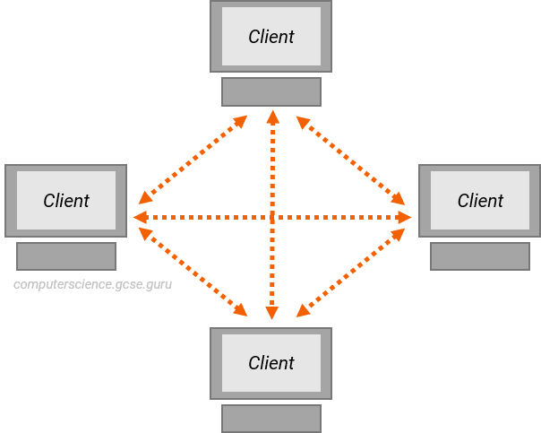
4.1 Understanding Peer-to-Peer (P2P) Concepts
The P2P process deals with a network structure where any participant in the network known as a node act as both a client and a server.
WHAT IS PEER-TO-PEER?
This means that, rather than relying on a basis server to supply resources or services, everybody from the network of nodes can trade resources and services with one another.

Slide 4
WHAT IS A PEER-TO-PEER (P2P) SERVICE?
A peer-to-peer network is a simple network of computers. It first came into existence in the late 1970s. Here each computer acts as a node for file sharing within the formed network. Here each node acts as a server and thus there is no central server in the network.

Slide 5
This allows the sharing of a huge amount of data. The tasks are equally divided amongst the nodes. Each node connected in the network shares an equal workload. For the network to stop working, all the nodes need to individually stop working. This is because each node works independently.
WHAT IS A PEER-TO-PEER (P2P) SERVICE?

Slide 6
HISTORY OF P2P NETWORKS
Before the development of P2P, USENET came into existence in 1979. The network enabled the users to read and post messages. Unlike the forums we use today, it did not have a central server. It is used to copy the new messages to all the servers of the node.
1980s
August 1988
the first use of P2P networks occurred after personal computers were introduced.
the internet relay chat was the first P2P network built to share text and chat.

Slide 7
HISTORY OF P2P NETWORKS
June 1999
August 1988
Napster was developed which was a file-sharing P2P software. It could be used to share audio files as well. This software was shut down due to the illegal sharing of files. But the concept of network sharing i.e P2P became popular.
Gnutella was the first decentralized P2P file sharing network. This allowed users to access files on other users' computers via a designated folder.

Slide 8
CONCEPT OF P2P
Decentralization
Resource Sharing
Unlike traditional client-server systems, P2P networks have no central server. Each peer can initiate or respond to requests, making the system more democratic and resilient.
Peers share files, bandwidth, or even computing power directly with one another. This makes P2P efficient for large-scale data distribution.
Equal Roles
Scalability
Every node (computer) in the network has equal status. A peer can download files, upload files, or provide services to others simultaneously.
As more peers join, the network becomes stronger and more capable of handling larger workloads without bottlenecks.

Slide 9
These networks do not involve a large number of nodes, usually less than 12. All the computers in the network store their own data but this data is accessible by the group.
FEATURES OF P2P NETWORK
Unlike client-server networks, P2P uses resources and also provides them. This results in additional resources if the number of nodes increases. It requires specialized software. It allows resource sharing among the network.
Since the nodes act as clients and servers, there is a constant threat of attack.
Almost all OS today support P2P networks.

Slide 10
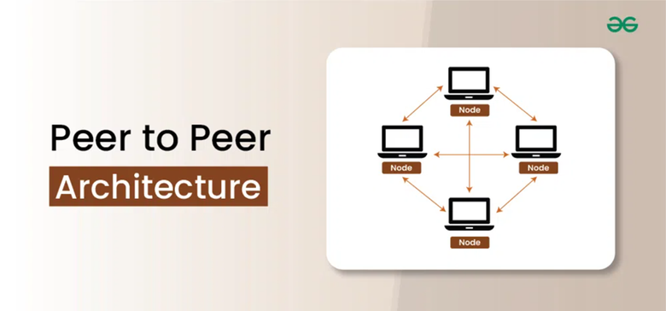
4.2 P2P Network Architectures and Application
Peer-to-peer (P2P) architecture is a a decentralized computing model where network participants share resources directly with each other without the need for a centralized server.
PEER-TO-PEER (P2P) ARCHITECTURE
This article provides a comprehensive overview of the P2P architecture, including its characteristics, benefits, types, key components, bootstrapping process, data management, routing algorithms, challenges, security techniques, and applications.

Slide 11
TYPES OF PEER-TO-PEER (P2P) NETWORKS
1. Pure P2P Networks
2. Hybrid P2P Networks
3. Overlay P2P Networks
Also known as decentralized
or true P2P networks, pure P2P networks operate without any central authority
or dedicated infrastructure.
Hybrid P2P networks combine elements of both decentralized and centralized architectures.
Overlay P2P networks create a virtual network on top of an existing infrastructure, such as the internet.
They typically include some central servers or super peers that coordinate network activities, manage resources, or provide additional services.
Overlay P2P networks often employ distributed hash tables (DHTs) or other routing mechanisms to locate and retrieve resources efficiently.
Examples include Chord and Kademlia.
Examples: BitTorrent and Gnutella.
Examples: Skype and eDonkey.

Slide 12
TYPES OF PEER-TO-PEER (P2P) NETWORKS
4. Structured P2P Networks
5. Unstructured P2P Networks
Structured P2P networks organize peers into a specific topology or structure, such as a ring, tree, or mesh.
In contrast to structured P2P networks, unstructured P2P networks do not impose any specific topology or organization on peers.
Structured P2P networks offer predictable performance and scalability but may require additional overhead for maintenance.
Peers in these networks typically rely on flooding or random search algorithms to locate resources, resulting in lower efficiency but greater flexibility and simplicity.
Examples include CAN (Content Addressable Network) and Pastry.
Examples include early versions of Gnutella and Freenet.

Slide 13
Peer Nodes
KEY COMPONENTS OF PEER-TO-PEER (P2P) SYSTEMS
Individual participants in a P2P network, each acting as both a client and a server.
Overlay Network
A virtual network topology that connects peer nodes and facilitates communication and resource sharing.

Slide 14
Indexing Mechanisms
KEY COMPONENTS OF PEER-TO-PEER (P2P) SYSTEMS
Systems for organizing and indexing shared resources, enabling efficient search and retrieval.
Bootstrapping Mechanisms
Processes for node discovery and network initialization that allow new nodes to join the network seamlessly.

Slide 15
The bootstrapping process in P2P networks involves discovering and initializing new nodes. This typically includes mechanisms for node discovery, network configuration, and connection protocols. Common bootstrap techniques include centralized bootstrap servers, distributed hash tables (DHTs), and peer exchange protocols.
BOOTSTRAPPING IN PEER-TO-Peer (P2P) Networks

Slide 16
DATA MANAGEMENT IN PEER-TO-PEER (P2P) NETWORKS
Data management in Peer-to-Peer (P2P) networks involves the storage, retrieval, replication, and consistency maintenance of data distributed across multiple peers.
Decentralized Storage
Data Retrieval
Each peer stores a piece of the data. This removes the "single point of failure," meaning the network stays up even if some computers go offline.
Since files are scattered, the network uses search algorithms to pinpoint exactly which peer has the data you need.

Slide 17
DATA MANAGEMENT IN PEER-TO-PEER (P2P) NETWORKS
Data management in Peer-to-Peer (P2P) networks involves the storage, retrieval, replication, and consistency maintenance of data distributed across multiple peers.
Replication
Consistency Management
The system creates multiple copies of files across different peers. This ensures the data is always available, even if the original owner leaves the network.
This ensures all copies of a file stay synchronized and updated across the entire network at the same time.

Slide 18
Advantages & Disadvantages of Peer-to-Peer (P2P) Networks
Advantages
Disadvantages
• Decentralization: There is no central server—each peer has an equal role, making the system more resilient and avoiding a single point of failure.
• Load Distribution: The workload is shared among multiple peers, improving efficiency and performance.
• Cost Reduction: It is more cost-effective since it does not require expensive centralized infrastructure—peers provide the resources.
• Content Availability: Data is replicated across peers, so content remains accessible even if some peers go offline.
• Scalability: As the network grows, it becomes harder to manage many peers and keep communication efficient.
• Security: P2P networks are more vulnerable to threats like malicious users, data tampering, and unauthorized access.
• Content Availability and Quality: Content may not always be reliable or high-quality due to peers going offline or having different resources.
• Data Management and Consistency: Keeping data organized, updated, and consistent across many peers is complex and difficult.

Slide 19
TECHNIQUES FOR SECURING PEER-TO-PEER (P2P) COMMUNICATION
Securing Peer-to-Peer (P2P) communication involves implementing various techniques to protect the confidentiality, integrity, and authenticity of data exchanged between peers.
Public Key Infrastructure (PKI)
Secure Hash Algorithms
Encryption
Data is encoded so that even if it is intercepted, it cannot be read without proper access.
Uses digital certificates to verify identities and enable secure communication between peers.
Create unique hash values (like SHA-256) to check if data has been altered.

Slide 20
TECHNIQUES FOR SECURING PEER-TO-PEER (P2P) COMMUNICATION
Securing Peer-to-Peer (P2P) communication involves implementing various techniques to protect the confidentiality, integrity, and authenticity of data exchanged between peers.
Secure Communication Protocols
Digital Signatures
Confirm the sender’s identity and ensure that the data has not been changed.
Protocols like TLS or SSL encrypt connections to keep data safe during transmission.

Slide 21
A Peer-to-Peer (P2P) application is any software or system that uses the P2P networking model where computers (peers) connect directly to each other to share resources, information, or services without relying on a central server.
PEER-TO-PEER APPLICATION
P2P Applications Use Cases
The P2P architecture has many applications in various domains, including:
File sharing
Content Distribution
Collaboration and Communication
Distributed Computing

Slide 22
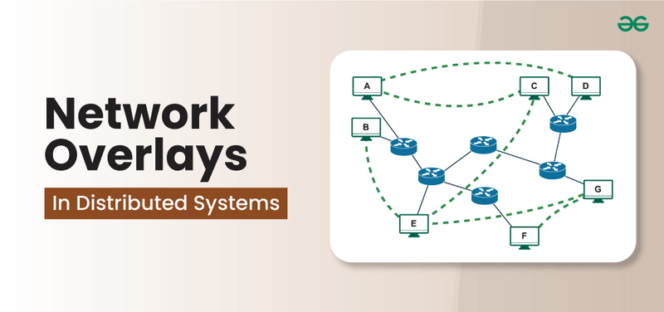
4.3 Overlay Network Protocols and Algorithms
A network overlay is a virtual network that runs on top of a physical network. It allows for creation of logical communication channels and connections between devices that may be geographically dispersed or belong to separate physical networks.
WHAT ARE NETWORK OVERLAYS?
Overlays are built using software-based layers that encapsulate the communication between nodes, hiding the underlying physical network's complexity.

Slide 23
CHARACTERISTICS OF NETWORK OVERLAYS
Abstraction: Overlays provide a virtualized view of the network, simplifying the management of complex infrastructures.
·Interoperability: They allow nodes from different networks or domains to communicate seamlessly.
·Custom Routing: Unlike physical networks, overlays can implement custom routing algorithms to optimize communication paths.
Flexibility: Overlay networks are adaptable to changes in network conditions, topology, or traffic.

Slide 24
IMPORTANCE OF OVERLAY NETWORKS IN DISTRIBUTED SYSTEMS
Distributed systems consist of multiple independent nodes that work together to perform a task. In such systems, communication between nodes is essential. The underlying physical network, however, might not always support the requirements of these systems. This is where overlay networks become important. They provide a unified communication model that abstracts the complexity of the physical network, enabling seamless interactions between nodes.

Slide 25
KEY BENEFITS OF OVERLAY NETWORKS IN DISTRIBUTED SYSTEMS
Scalability: Overlays allow distributed systems to scale efficiently by adding or removing nodes without impacting the overall system.
·Dynamic Topology Management: As nodes join or leave the network, overlays can quickly adjust the logical topology, maintaining a stable communication framework.
Fault Tolerance:Through redundancy and alternative routing paths, overlays increase the fault tolerance of distributed systems.
Optimized Resource Usage: Overlay networks enable better utilization of network resources, reducing congestion and latency.

Slide 26
TYPES OF NETWORK OVERLAY MODELS
1. Structured Overlay Networks
Organized networks with a fixed structure where data is stored and found efficiently using systems like DHT.
Key Characteristics:
• Data is placed in specific nodes using a hash function
• Fast and efficient searching
• Easy to scale as the network grows
Examples: Chord, Pastry

Slide 27
TYPES OF NETWORK OVERLAY MODELS
2. Unstructured Overlay Networks
Flexible networks with no fixed structure—nodes connect randomly.
Key Characteristics:
• No strict organization
• Data is found by searching (flooding or gossiping)
• Can handle changes easily but slower in searching
Examples: Gnutella, Freenet

Slide 28
TYPES OF NETWORK OVERLAY MODELS
3. Hierarchical Overlay Networks
Networks organized in levels, with groups of nodes managed by “super nodes.”
Key Characteristics:
• Nodes are grouped into clusters
• Super nodes manage communication between groups
• More efficient and scalable
Example: Super-peer networks (e.g., Kazaa)

Slide 29
Routing in overlay networks involves determining the most efficient path for data to travel between nodes, considering both the overlay and the underlying physical network. Different routing techniques are employed based on the type of overlay:
·Proximity Routing: Nodes route data through the nearest available neighbor, minimizing latency.
·Source Routing: The sender determines the entire route, specifying the path the data should take through the network.
·Greedy Routing: Nodes forward data to the neighbor that is closest to the destination in terms of logical distance.
·Flooding: In unstructured networks, data is broadcast to all neighbors, ensuring that it reaches its destination.
·Hierarchical Routing: In hierarchical networks, data is routed through super nodes, which manage inter-cluster communication.
OVERLAY ROUTING TECHNIQUES

Slide 30
APPLICATIONS OF OVERLAY NETWORKS IN DISTRIBUTED SYSTEMS
Overlay networks are widely used across various domains of distributed systems:
Content Delivery Networks (CDNs): CDNs use overlays to distribute content across multiple servers, reducing latency and load on the central servers.
Peer-to-Peer (P2P) Systems: P2P applications like file-sharing (e.g., BitTorrent) and decentralized computing use overlays for efficient data distribution.
Internet of Things (IoT): Overlays help connect diverse IoT devices across different networks, facilitating communication and data exchange.
Blockchain Networks: Many blockchain implementations use overlay networks to manage peer-to-peer communication and transaction validation.
Virtual Private Networks (VPNs): VPNs create a secure overlay on top of the public internet, allowing secure communication between nodes.

Slide 31
Advantages & Disadvantages of Network Overlays in Distributed Systems
Advantages
Disadvantages
Scalability: Overlays can easily scale to support thousands or millions of nodes.
·Fault Tolerance: Through redundant paths and routing mechanisms, overlays ensure data is still accessible even when nodes fail.
Efficient Resource Usage: Custom routing and load-balancing techniques help optimize network traffic.
Flexibility: Overlays can be adapted to different physical networks and optimized for various application needs.
Latency: Additional routing layers may introduce latency, especially in large-scale overlays.
Network Congestion: In unstructured overlays, the use of flooding and broadcast mechanisms can lead to congestion.
Management Complexity: Maintaining the overlay structure, especially in dynamic environments, can be complex.
Data Consistency: In peer-to-peer systems, ensuring that all nodes have consistent data is a major challenge.

Slide 32
SECURITY IN OVERLAY NETWORKS
Security is a crucial aspect of overlay networks, especially in distributed systems where data is shared across multiple nodes. Several security challenges arise due to the virtual nature of overlays:
Data Privacy: Ensuring that data is encrypted and only accessible to authorized nodes.
Authentication: Verifying the identity of nodes in the network to prevent unauthorized access.
Denial of Service (DoS) Attacks: Overlay networks can be vulnerable to DoS attacks, where malicious nodes flood the network with traffic.
Routing Security: Ensuring that malicious nodes do not tamper with or reroute data.

Slide 33
SECURITY TECHNIQUES
Encryption: Secure data transmission using end-to-end encryption.
Node Authentication: Digital certificates or cryptographic methods to verify the identity of nodes.
Consensus Mechanisms: In blockchain-based overlays, consensus algorithms ensure the integrity and validity of transactions.
Redundant Routing: Implementing multiple routing paths to prevent a single point of failure.

Slide 34
REFERENCES
What is P2P (Peer-to-Peer Process)? - GeeksforGeeks
Peer-to-Peer (P2P) Architecture - GeeksforGeeks
Network Overlays in Distributed Systems - GeeksforGeeks

